Slide 1
I extended the prior on pre-bot t down to 1 (1-100)
I extended bot ne to 1-10,000

Slide 2
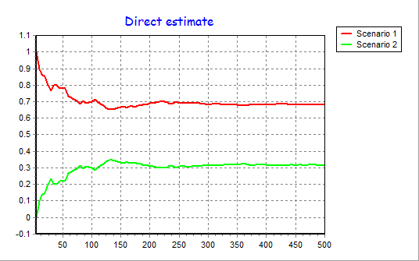
Type I error rate = 0.436; Type II error rate = 0.322
I think that the case of the Antarctic Fur Seals was an exceptionally strong case of support. I would not be to surprised if we looked at other published studies we would find that the GFS support is comparable.

Slide 3
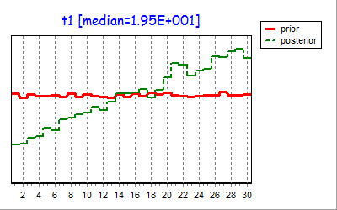
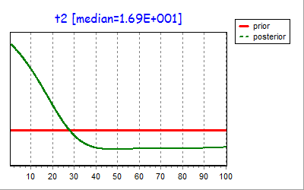
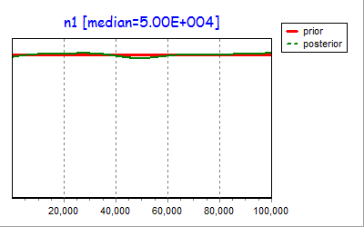
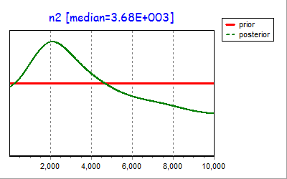
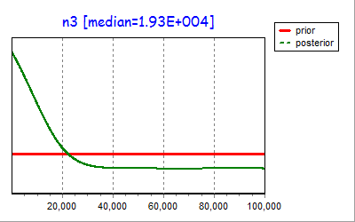
As you see, the value for t1 is greater than the value for t2. I have ran additional analyses with the constraint that t1 always be < than t2 when drawing from distributions. The results of those analyses don’t support the bottleneck over constant. I haven’t yet been able to clearly understand quite yet what the the results below mean with respect to the timing of bottleneck events or the ability to draw a picture of the demographic history.

